Slide 1
The Docker Playbook
A Walkthrough on Using Docker for Model Pipelines
Zuri Hunter
Full Stack Engineer
Data and Analytics

Slide 2
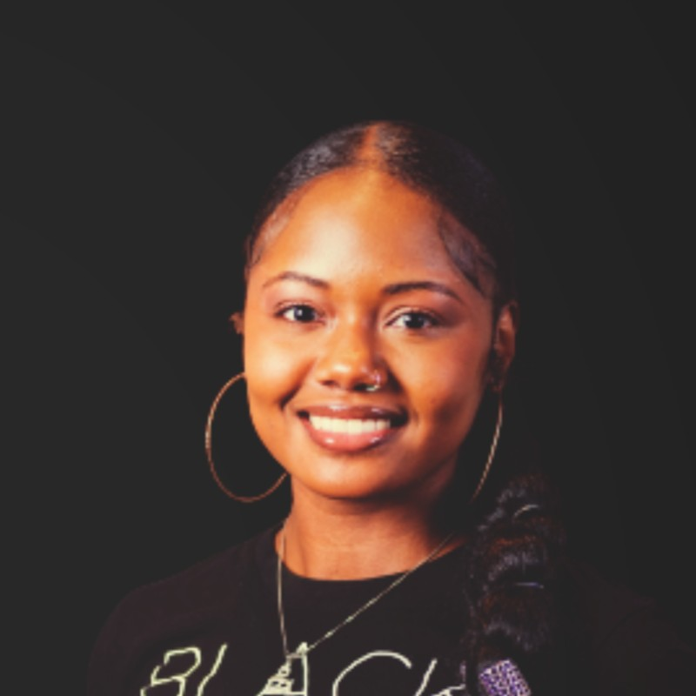

Zuri Hunter
Full Stack Engineer
Data Analytics

Slide 3
What's In the playbook?
Deployment Dilemma
Docker Fundamentals
Containerize the Model Pipeline
Cloud and Terraform Fundamentals
Code Walkthrough
Q&A

Slide 4



The Deployment Dilemma
Dependency Hell
Inconsistent environments and incompatible packages stalls reproducibility.
Scaling Issues
Training locally is easy but iterating and scaling to the cloud is a different game.
Manual Overhead
Manual steps is laborious and allows for multiple errors in the process.
Notes:
You are in the midst of the 4th quarter of delivering your model but you need to use the cloud to run because the production data lives there. You send it off to your DevOps engineer and they try to run it in the cloud and everything breaks!
So you think to yourself what on earth happened! It ran perfectly on your computer but why is it breaking in the cloud? What could be the culprit?
Conflicting libraries, different OS setups, missing packages? Maybe? It can be a plethora of things when it comes to the cloud. But the one thing you and the DevOps engineer know is that it what works on one machine collapses on another.
How do we get to the endzone and iterate over our model at scale.
Cloud environments sometimes add layers of complexity, in so without automation in place this can be a cumbersome challenge.

Slide 5
Docker
FUNDAMENTALS
Notes:
That is when we turn to a tool that has been in the industry for a while that helps us leverage virtualization. Docker

Slide 6
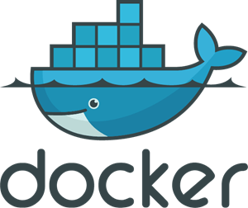
Is a software platform that empowers everyone to build, share and run applications on any platform using containers.
Notes:
The ideal of this technology is to by pass someone saying “Well it worked on my machine.”

Slide 7
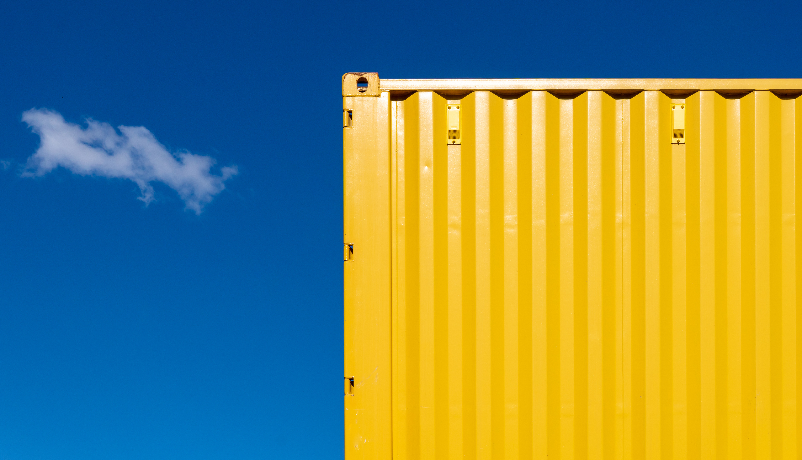
Docker Fundamentals
Containerization
Is a one of the many methods of computer virtualization.
It allows for applications to run in isolated environments.
Think of it as a computer cloning itself.

Slide 8
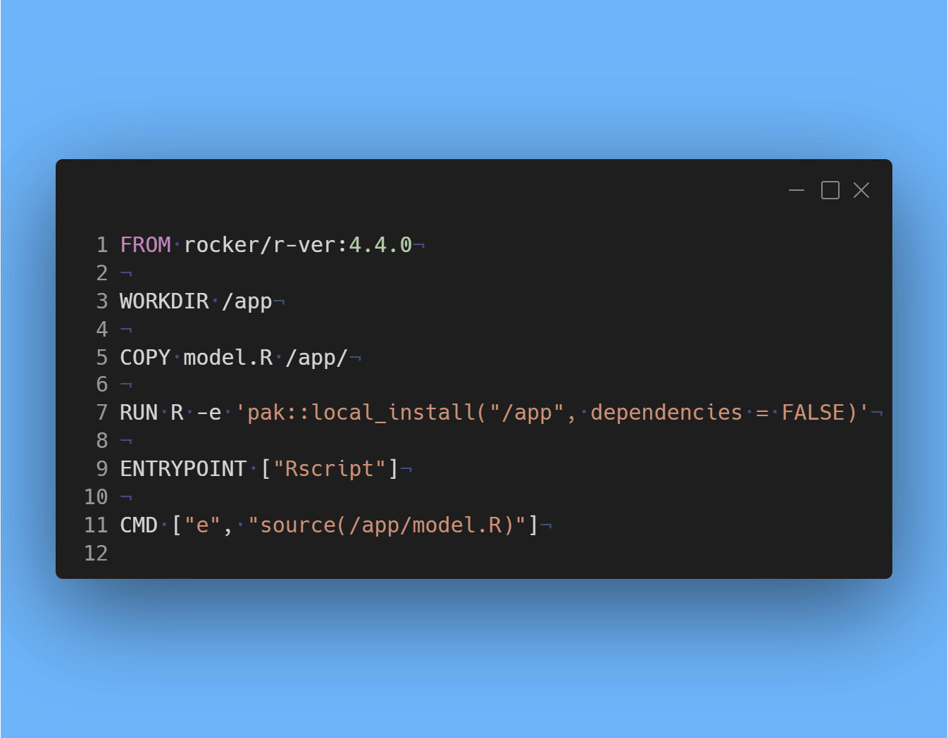
Dockerfile
Is a script that defines the steps to create a blueprint of your container.
Docker Image
Is a blueprint on how to build and run your code.

Slide 9
Essential Dockerfile Commands
FROM is an instruction that specifies the base image that lays the groundwork. Used in multi-stage builds.
RUN executes specific commands within the container during the build process.
COPY transfers files from the host to the container file system.
CMD defines the default actions within the container when it runs.
ENTRYPOINT permits the container to run an executable.

Slide 10

Containerize the Model Pipeline
Current Script (Python)
Reads tracking data from a data source.
Trains the model.
Predicts the results on a series of variables.
Send the results to another source.

Slide 11
Containerize the Model Pipeline
Create a file called Dockerfile at the root of the model.
Use AWS Lambda Python as a base image.
Copy the content of the script into the directory including the dependency file.
Install script dependencies.
Run the script.

Slide 12
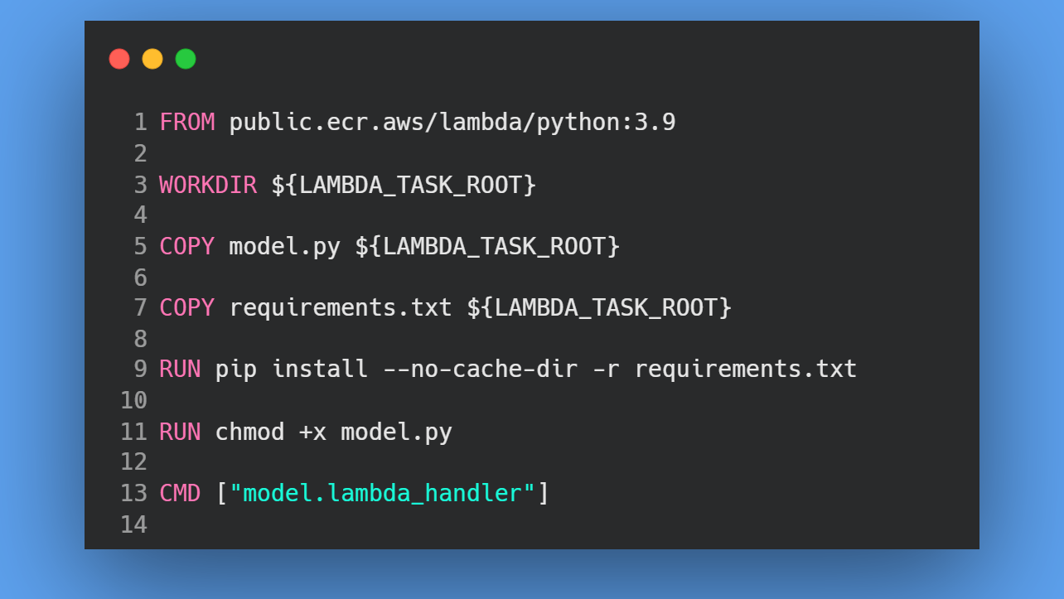

Slide 13
Cloud and Terraform
FUNDAMENTALS

Slide 14
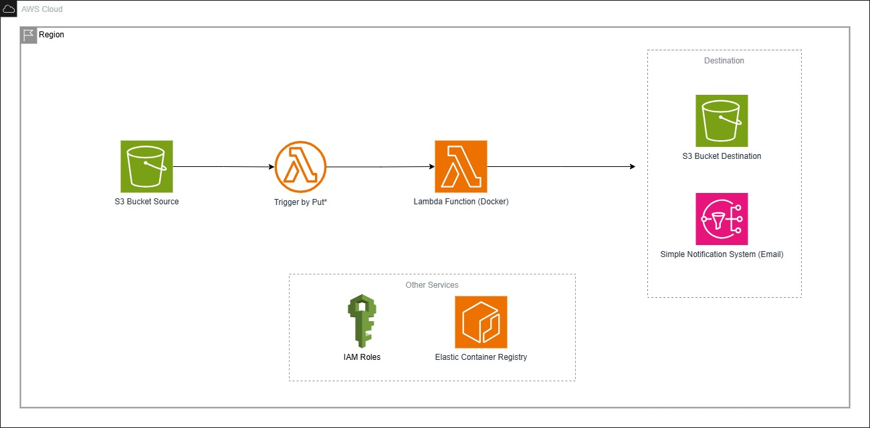
Cloud and Terraform Fundamentals

Slide 15
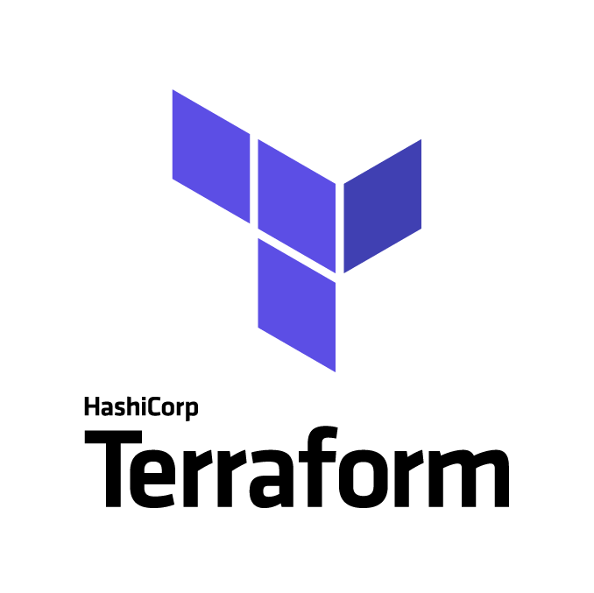
Is an open source infrastructure as code tool used to programmatically provision and manage both on premise and cloud resources.

Slide 16


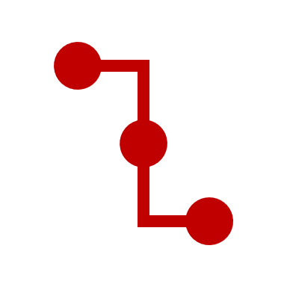
Cloud and Terraform Fundamentals
Declarative Language
Allows for you to describe infrastructure in *.tf files and manages state.
Platform Agnostic
Works with most cloud providers and on-premise servers.
Version Control
Allows for versioning, review and rollback infrastructure.

Slide 17
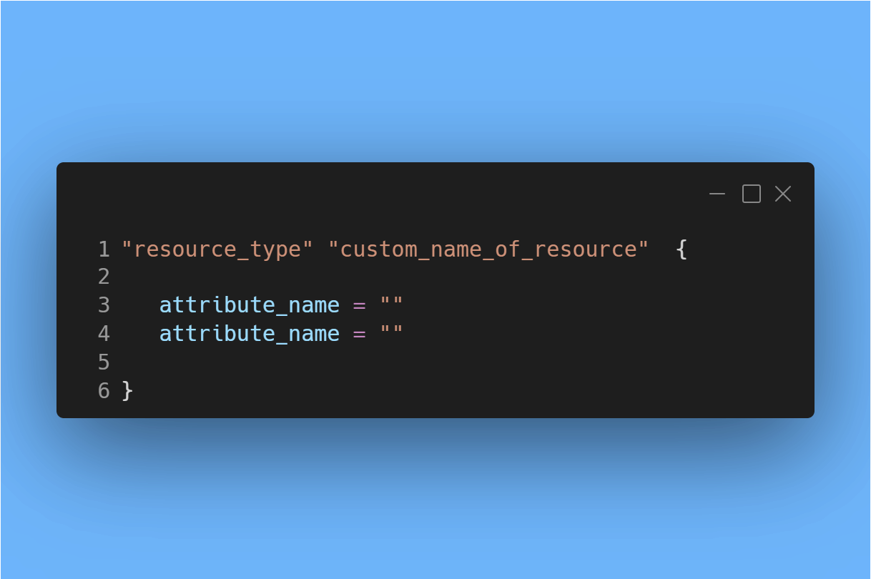
Each resource starts with the name of the resource and then fill in the attribute of the resource.

Slide 18
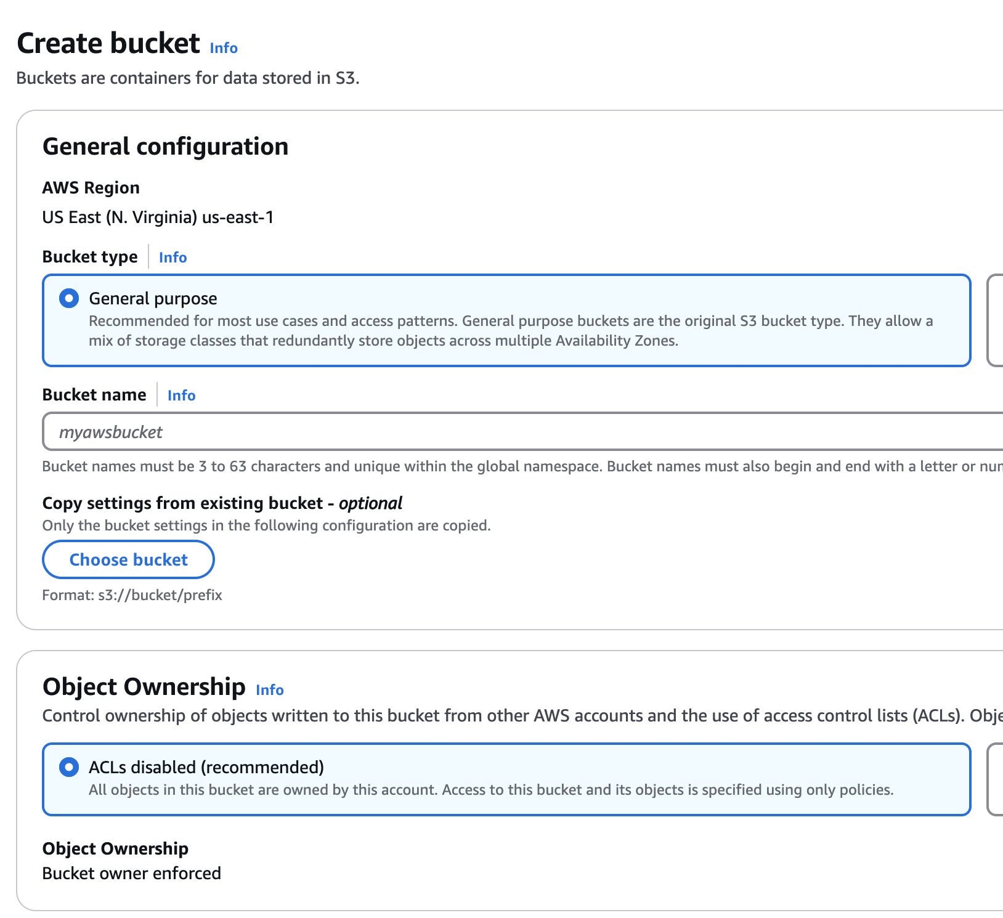
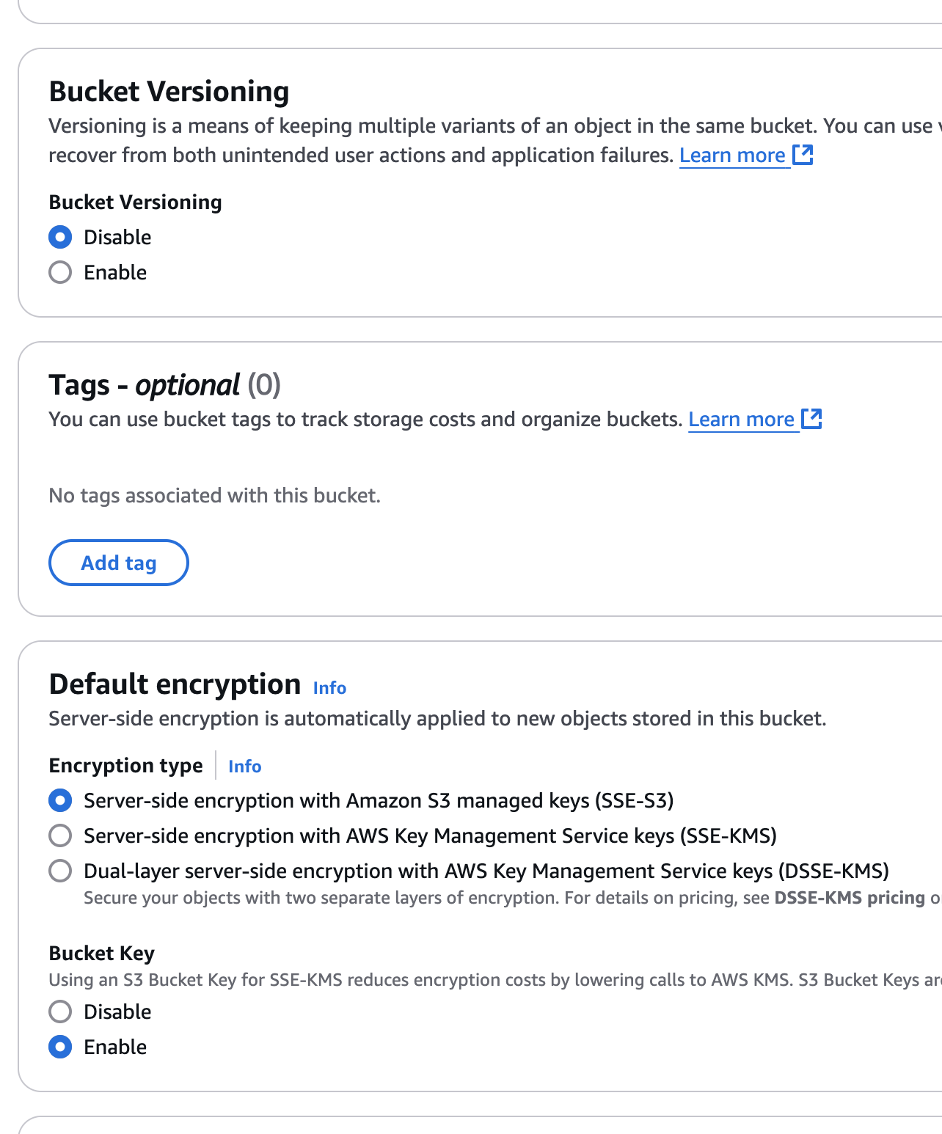

Slide 19
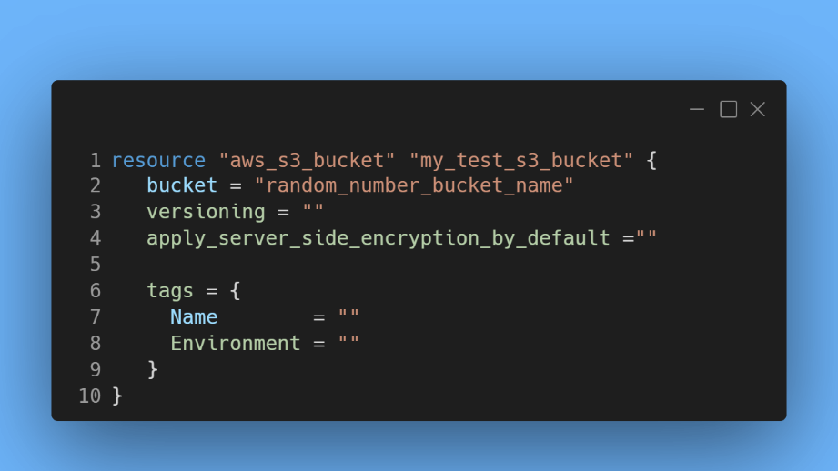

Slide 20
Cloud and Terraform Fundamentals
Configure you AWS account role/user to be able to create the following resources:
IAM
Elastic Container Registry
Lambda
S3
Simple Notification System
Cloudwatch

Slide 21
Code
WALKTHROUGH

Slide 22
Questions
Zuri Hunter
Full Stack Engineer
Data and Analytics

